Slide 1

Computer Fundamentals
By Krishna Chakravarty
Associate Professor
KIIT Deemed to be University

Slide 2
contents
Day 1
What is a computer
Why computers
Disadvantages
Use of computers

Slide 3
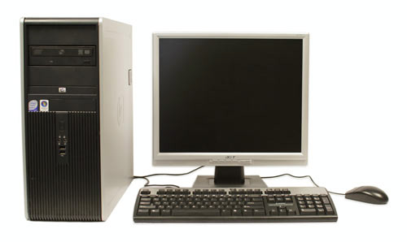


What is a COMPUTER?
An electronic device which is capable of receiving information (data) in a particular form and of performing a sequence of operations in accordance with a predetermined but variable set of procedural instructions (program) to produce a result in the form of information or signals.
Please note above
Electronic apparatus (although the first computers were mechanical and electro-mechanical)
Data processing
Computer assisted controls or operations
Can perform only those operations or calculations that can be expressed in logical and numerical terms.

Slide 4

What does computer do?
A computer is an electronic data processing device, which accepts and stores data input, processes the data input, and generates the output in a required format.
Input
Output
Process
Data/Instructions

Slide 5
WHY COMPUTERS ?
High Speed
Computer is a very fast device.
It is capable of performing calculation of very large amount of data.
It can perform millions of calculations in a few seconds as compared to man who will spend many months to perform the same task.
Accuracy
In addition to being very fast, computers are very accurate.
Computers perform all jobs with 100% accuracy provided that the input is correct.
Storage Capability
Memory is a very important characteristic of computers.
A computer has much more storage capacity than human beings.
It can store large amount of data.
It can store any type of data such as images, videos, text, audio, etc.

Slide 6
WHY COMPUTERS ? More reasons
Diligence
Unlike human beings, a computer is free from monotony, tiredness, and lack of concentration.
It can work continuously without any error and boredom.
It can perform repeated tasks with the same speed and accuracy.
Versatility
A computer is a very versatile machine.
A computer is very flexible in performing the jobs to be done.
This machine can be used to solve the problems related to various fields.
At one instance, it may be solving a complex scientific problem and the very next moment it may be playing a card game.
Reliability
A computer is a reliable machine.
Modern electronic components have long lives.
Computers are designed to make maintenance easy.

Slide 7
WHY COMPUTERS ? More reasons
Automation
Computer is an automatic machine.
Automation is the ability to perform a given task automatically. Once the computer receives a program i.e., the program is stored in the computer memory, then the program and instruction can control the program execution without human interaction.
Reduction in Paper Work and Cost
The use of computers for data processing in an organization leads to reduction in paper work and results in speeding up the process.
As data in electronic files can be retrieved as and when required, the problem of maintenance of large number of paper files gets reduced.
Though the initial investment for installing a computer is high, it substantially reduces the cost of each of its transaction.

Slide 8
Disadvantages
No I.Q.
A computer is a machine that has no intelligence to perform any task.
Each instruction has to be given to the computer.
A computer cannot take any decision on its own.
Dependency
It functions as per the user’s instruction, thus it is fully dependent on humans.
Environment
The operating environment of the computer should be dust free and suitable.
No Feelings
Computers have no feelings or emotions.
It cannot make judgment based on feeling, taste, experience, and knowledge unlike humans.

Slide 9

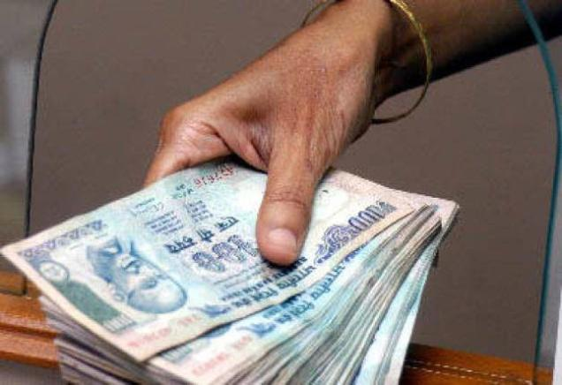
USE of COMPUTERS
Business
Payroll calculations
Budgeting
Sales analysis
Financial forecasting
Managing employee database
Maintenance of stocks, etc
Banking
Payroll calculations
Budgeting
Sales analysis
Financial forecasting
Managing employee database
Maintenance of stocks, etc

Slide 10
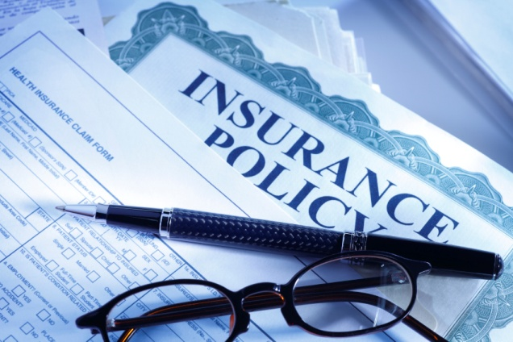

USE of COMPUTERS
Insurance
Payroll Procedure to continue with policies
Starting date of the policies
Next due installment of a policy
Maturity date
Interests due
Survival benefits
Bonus
Education
Keep students’ records
Computer based learning
Admission process
Placement centre

Slide 11
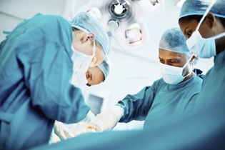
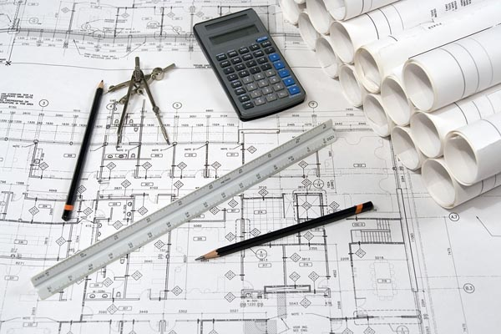
USE of COMPUTERS
Health care
Diagnostic system
Patient monitoring system
Hospital administration
Pharma information system
Engineering design
Structural engineering
Architectural engineering
Industrial engineering

Slide 12
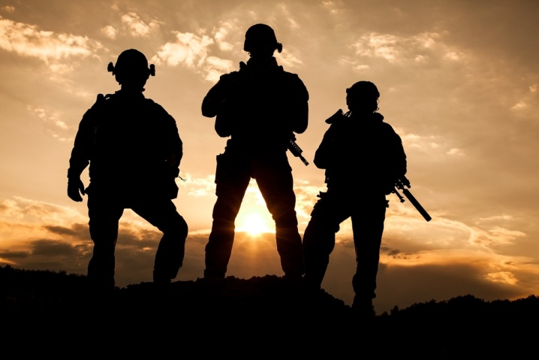

USE of COMPUTERS
Military
Missile Control
Military Communication
Military Operation and Planning
Smart Weapons
Communication and social media
Email
Facebook
Twitter
Video conferencing
whatsapp

Slide 13
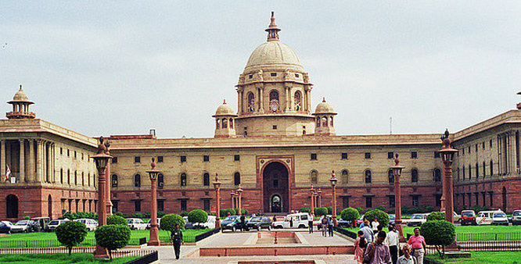
USE of COMPUTERS
Government services
Budgets
Sales tax department
Income tax department
Computation of male/female ratio
Computerization of voters lists
Computerization of PAN card
Weather forecasting

